Slide 1
Oxenwood Residential Visit
Wednesday 24th – Friday 26th June 2026
Mrs Helsby, Mrs Sammon, Ms Parsons
Leave at 9 am on Wednesday
Be back by 3.15 on Friday
Photos – website
Children to bring packed lunch – disposable bag
Water bottle – to use during week

Slide 2
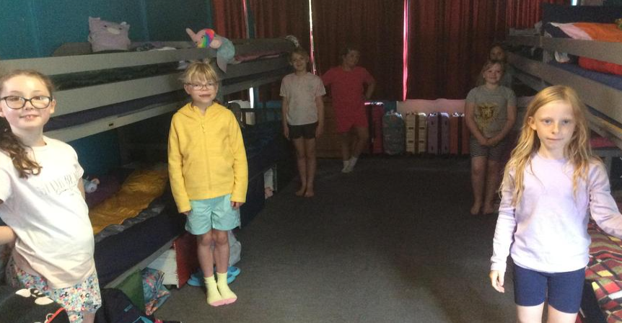
Children to bring their own sleeping bags and pillow cases.
Can bring some paper/small games
No phones/electronic games

Slide 3
Food & equipment
All meals are provided by the centre
Most dietary requirements can be catered for
kit list will be put on class page of website
(No phones, gadgets or valuables!)
Slippers or trainers inside
Couple of pairs of trainers for activities
Sun cream/sun hats/ water bottle
No need for any money

Slide 4
Any questions?

