Slide 1

Digital Parenting & Exploitation

Slide 2
What are you going to learn about?
What is suitable technology for your children.
What should my child not have access to.
What are the dangers.
How to keep my children safe online.
What help and support is there?

Slide 3









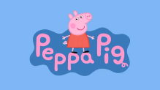

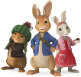










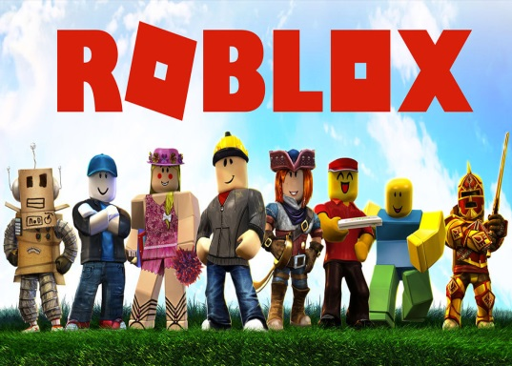







What can my child look at on line?

Slide 4














What should they not have access to?

Slide 5

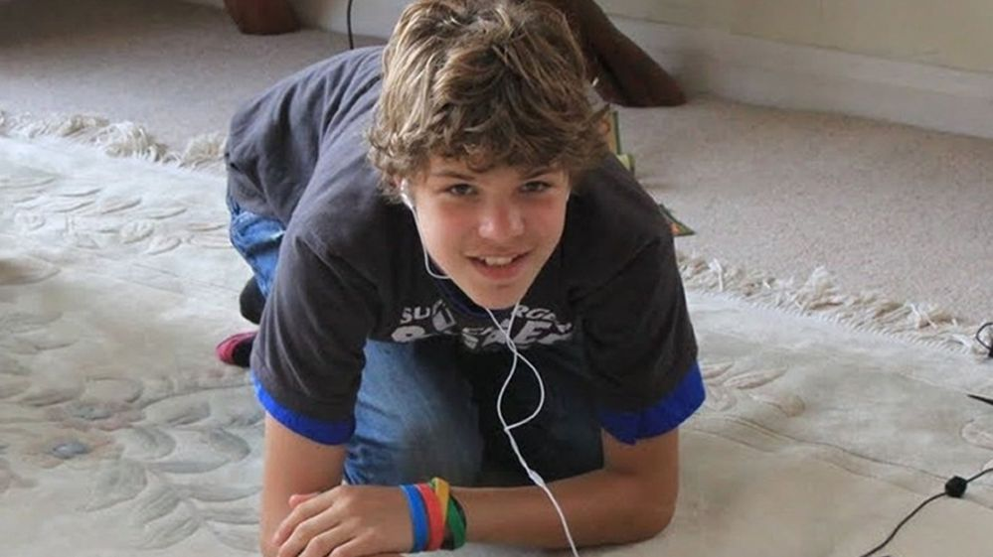
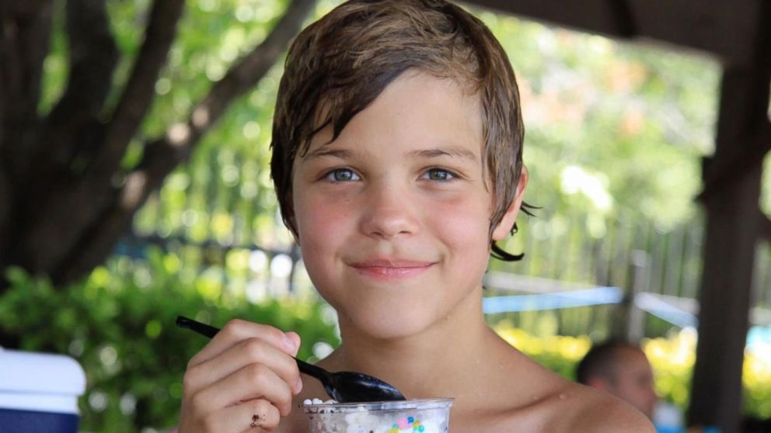
Breck Bednar

Slide 6
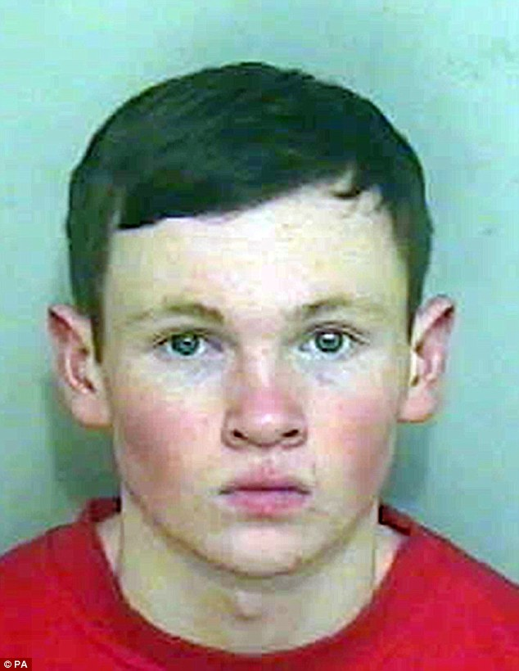
Lewis Daynes

Slide 7
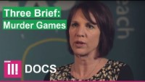

Slide 8
TIKTOK (13 +)
Over 1.59 billion monthly users, TikTok has young people dancing and lip-syncing across the world right now and it certainly doesn’t seem to be getting any less popular.
Many children see them as celebrities and aspire to become successful TikTokers themselves.
There are similar risks to other social media networks such as exposure to inappropriate content, grooming and bullying.
Children should be reminded to think carefully about what they share and with whom when using the app. Have a play around with it yourself to see how it works.

Slide 9
DISCORD (13 +) Apple say 17+
Similar to leading live streaming platform Twitch, Discord allows users to chat to other users publicly and privately whilst playing their favourite video games.
As with any app that provides one-to-one or group chat features, Discord can lead to bullies or groomers interacting online with your child, or the possibility of them seeing inappropriate content.

Slide 10
https://www.vodafone.co.uk/mobile/digital-parenting/code-kid

Slide 11


Slide 12
https://fb.watch/slXzn25s82/?mibextid=WC7FNe

Slide 13
Exploitation- What does it mean?
Someone taking ………….. of you, for their own …………..; through ……., bribes, ………, or humiliation. Giving them the …… to get you to do things for their….., or other people’s benefit
ADVANTAGE
POWER
THREATS
VIOLENCE
BENEFIT
OWN

Slide 14
Exploitation- What does it mean
Someone taking ADVANTAGE of you, for their own BENEFIT, through THREATS, bribes, VIOLENCE, or humiliation. Giving them the POWER to get you to do things for their OWN, or other people’s benefit.

Slide 15
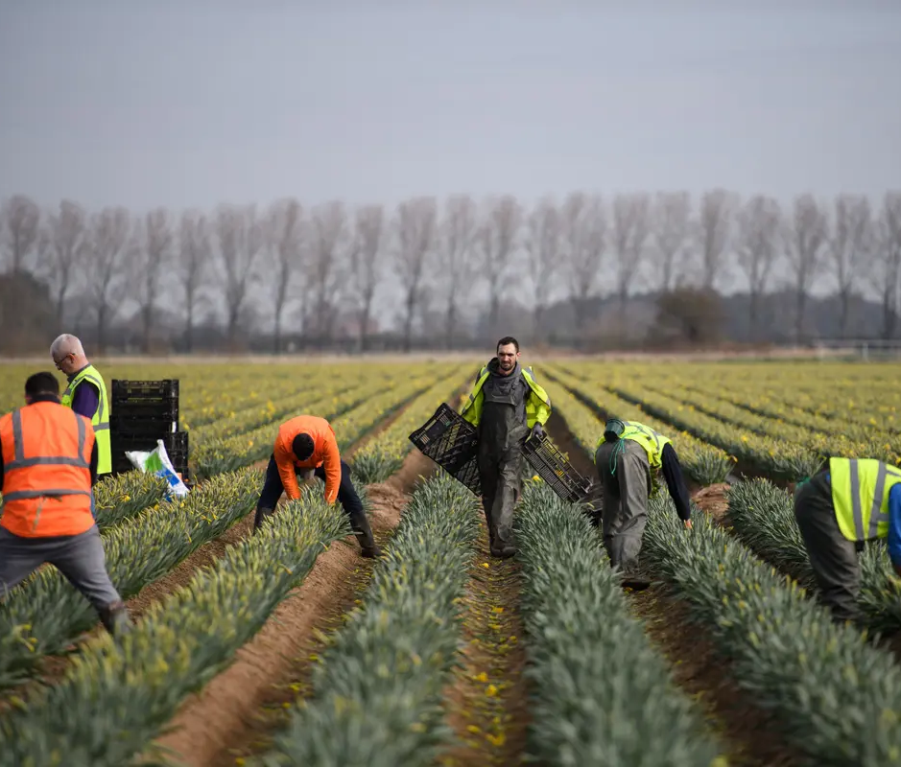
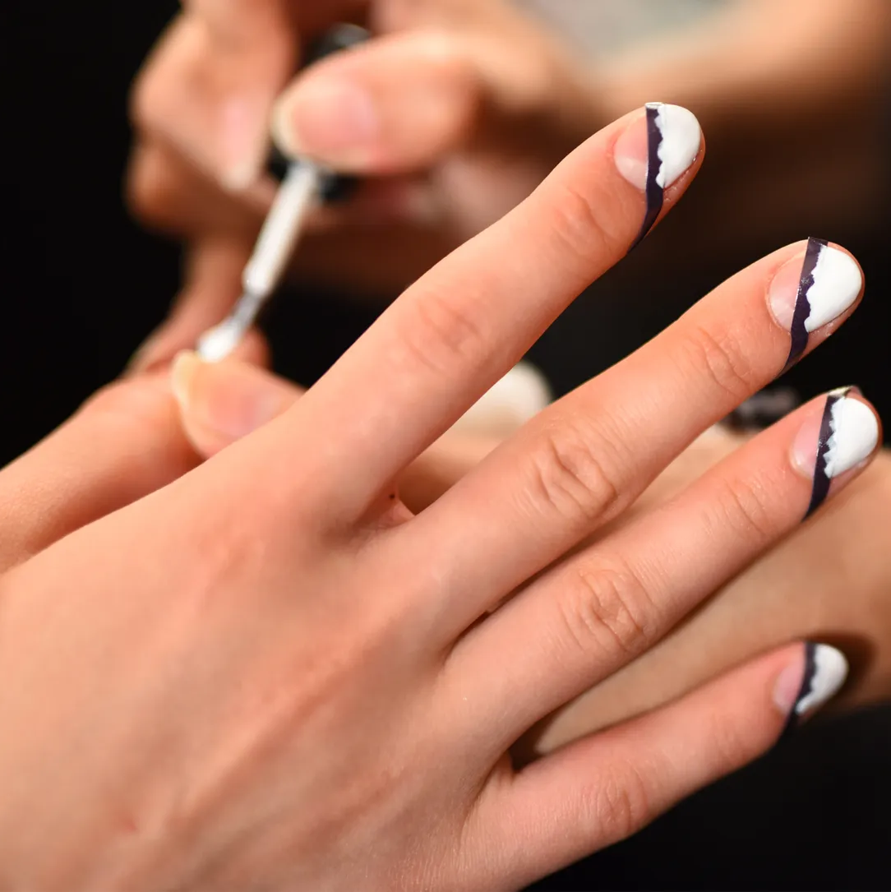
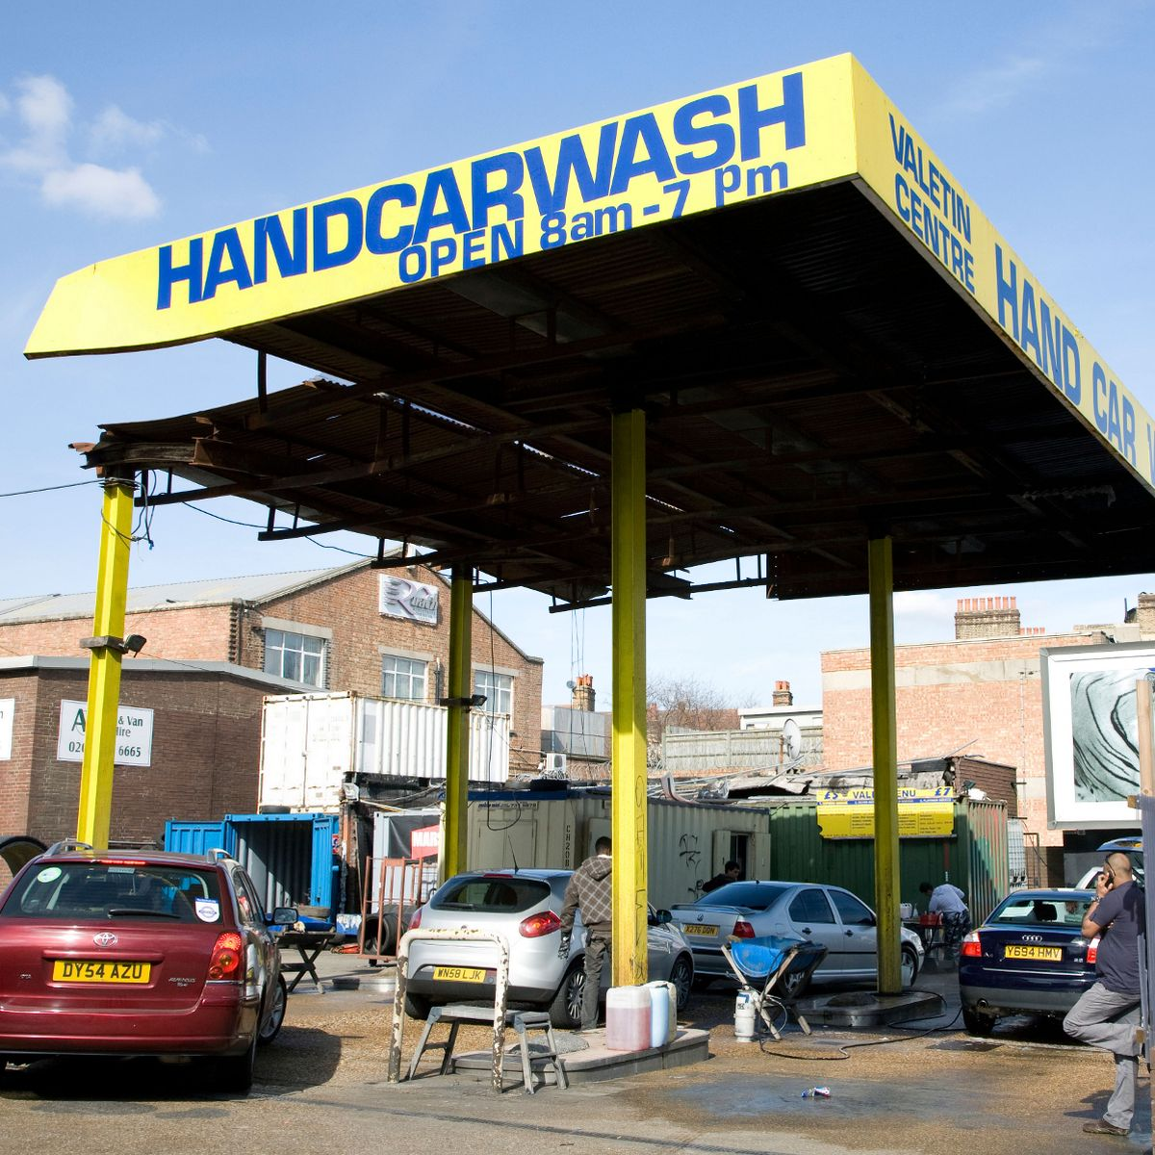
Before we continue…
Where might we see exploitation in our communities?

Slide 16
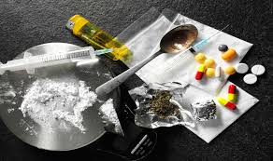
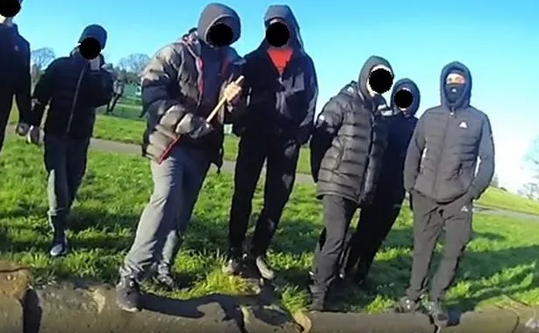

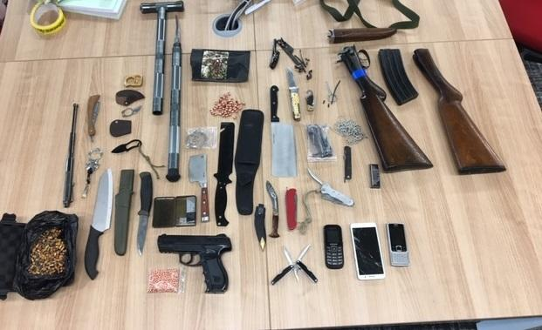

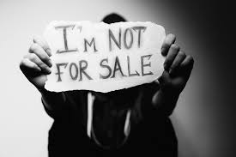
Some examples of Exploitation…
Forced to sell drugs
Gang affiliation
Going missing
Forced to carry weapons
Abuse / Violence
Trafficked

Slide 17
4 Models of exploitation
Peer on Peer
Young people are sexually exploited by peers who are known to them at school, in the neighbourhood or through friends.
Befriending Model
Young people are befriended in person or online. That young person then introduces them to one or more older males, they may be described as an older brother or cousin. This can be exciting as the older male will treat them really nicely to start with.
The Boyfriend Model
They target young people posing as a “boyfriend”. They shower them with attention and gifts to make them feel special. An intermate sexual relationship starts which the other person is expected to return as “proof” of his/her love or as payback.
The Party Model
Parties are organised to lure young people. You would be offered drink, drug car rides all for free. You would be introduced to an exciting environment sexual promiscuity and violence is normalised. These parties are held all over the place, RAVES are popular at the moment.

Slide 18

Recognising the signs
Do they suddenly have lots of money/lots of new clothes/new mobile phones/new vape?
Are they travelling alone to places far away from home?
Are they always going missing from school or home?
Do they seem scared or anxious?
Are they selling or carrying drugs?
Are they carrying weapons or know people that have access to weapons?
Do they have unexplained injuries?

Slide 19
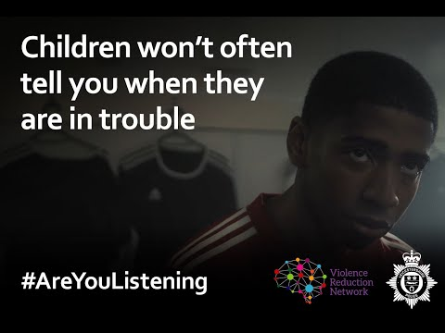

Slide 20


Slide 21








